Slide 1
Data 100 SQL Review
. . .
Slides By:
Joseph E. Gonzalez
Joseph Hellerstein
Josh Hug
Sona Jeswani
Karina Goot
Allen Shen
Neil Shah
Paul Shao

Slide 2
SQL Resources
CS61A Fall 2018 Lectures 32, 33, 34, 35 [John DeNero]
https://inst.eecs.berkeley.edu/~cs61a/fa18/
Composing Programs Section 4.3 [John DeNero, Allen Shen, et al.]
http://composingprograms.com/pages/43-declarative-programming.html
DS100 Fall 2018 Lecture 22 [Josh Hug]
http://www.ds100.org/fa18/syllabus
DS100 Textbook Section 9.2 [Sam Lau, Junseo Park, Ananth Agarwal, et al.]
https://www.textbook.ds100.org/ch/09/sql_basics.html

Slide 3
SQL
What not How

Slide 4
SQL is a Declarative Language
Declarative: “Say what you want, not how to get it.”
Declarative Example: I want a table with columns “x” and “y” constructed from tables “A” and ”B” where the values in “y” are greater than 100.00.
Imperative Example: For each record in table “A” find the corresponding record in table “B” then drop the records where “y” is less than or equal to 100 then return the ”x” and “y” values.
Advantages of declarative programming
Enable the system to find the best way to achieve the result.
Often more compact and easier to learn for non-programmers
Challenges of declarative programming
System performance depends heavily on automatic optimization
Limited language (not Turing complete)

Slide 5
Relational Terminology
Database: Set of Relations (i.e., one or more tables)
Relation (Table):
Schema: description of columns, their types, and constraints
Instance: data satisfying the schema
Attribute (Column)
Tuple (Record, Row)
Schema of database is set of schemas of its relations

Slide 6

Two sublanguages of SQL
DDL – Data Definition Language
Define and modify schema
DML – Data Manipulation Language
For interacting with the data itself
CAPITALIZATION IS optional BUT … DATABASE PEOPLE PREFER TO YELL
SELECT * FROM THINGS;

Slide 7
Creating Tables & Populating Tables

Slide 8
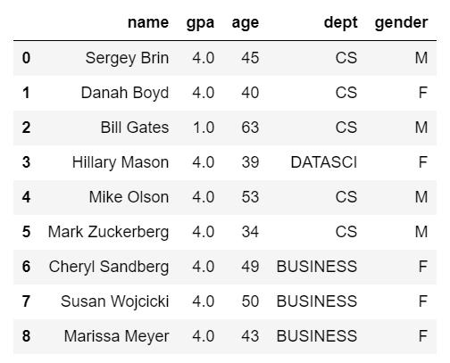
Creating Tables
CREATE TABLE students(
name TEXT PRIMARY KEY,
gpa REAL CHECK (gpa >= 0.0 and gpa <= 4.0),
age INTEGER,
dept TEXT,
gender CHAR);
Imposing Integrity Constraints
Useful to ensure data quality…

Slide 9
Inserting Records into a Table
INSERT INTO students
VALUES
('Sergey Brin', 2.8, 45, 'CS', 'M'),
('Danah Boyd', 3.9, 40, 'CS', 'F'),
('Bill Gates', 1.0, 63, 'CS', 'M'),
('Hillary Mason', 4.0, 39, 'DATASCI', 'F'),
('Mike Olson', 3.7, 53, 'CS', 'M'),
('Mark Zuckerberg', 3.8, 34, 'CS', 'M'),
('Cheryl Sandberg', 3.6, 49, 'BUSINESS', 'F'),
('Susan Wojcicki', 3.8, 50, 'BUSINESS', 'F'),
('Marissa Meyer', 2.6, 43, 'BUSINESS', 'F’)
-- This is a comment.
-- Does the order matter?
(name, gpa, age, dept, gender) ← Optional
Fields must be entered in order (record)
Comma between records
Must use the single quote (’) for strings.
No
http://sqlfiddle.com/#!9/120e17/1/0
Note: These GPA values are totally arbitrary.

Slide 10
Common SQL Types (there are others...)
CHAR(size): Fixed number of characters
TEXT: Arbitrary number of character strings
INTEGER & BIGINT: Integers of various sizes
REAL & DOUBLE PRECISION: Floating point numbers
DATE & DATETIME: Date and Date+Time formats
See documentation for database system (e.g., Postgres)

Slide 11
CREATE TABLE Sailors (
sid INTEGER,
sname CHAR(20),
rating INTEGER,
age REAL,
PRIMARY KEY (sid));
CREATE TABLE Boats (
bid INTEGER,
bname CHAR (20),
color CHAR(10),
PRIMARY KEY (bid));
CREATE TABLE Reserves (
sid INTEGER,
bid INTEGER,
day DATE,
PRIMARY KEY (sid, bid, day),
FOREIGN KEY (sid) REFERENCES Sailors,
FOREIGN KEY (bid) REFERENCES Boats);
Columns have names and types
sid | sname | rating | age
1 | Fred | 7 | 22
2 | Jim | 2 | 39
3 | Nancy | 8 | 27
Specify Primary Key column(s)
bid | bname | color
101 | Nina | red
102 | Pinta | blue
103 | Santa Maria | red
Specify Foreign Key relationships
sid | bid | day
1 | 102 | 9/12
2 | 102 | 9/13
Semicolon at end of command

Slide 12
Deleting and Modifying Records
Records are deleted by specifying a condition:
Modifying records
Note: There is no way to modify records by location
DELETE FROM students
WHERE LOWER(name) = 'sergey brin'
String Function
UPDATE students
SET gpa = 1.0 + gpa
WHERE dept = ‘CS’;

Slide 13
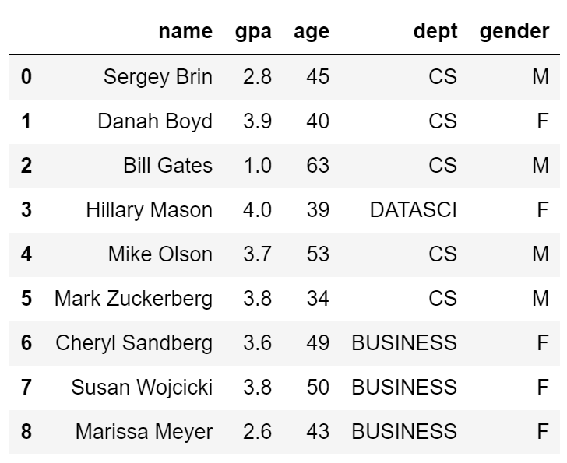
Deleting and Modifying Records
What is wrong with the following
UPDATE students
SET gpa = 1.0 + gpa
WHERE dept = ‘CS’;
CREATE TABLE students(
name TEXT PRIMARY KEY,
gpa FLOAT CHECK (gpa >= 0.0 and gpa <= 4.0),
age INTEGER,
dept TEXT,
gender CHAR);
Update would violate Integrity Constraints

Slide 14

Dropping Tables
To delete a table entirely from our database, we can use the “DROP TABLES” command.
Example: DROP TABLE tips;
Be careful, there is no easy way to undo this command.

Slide 15
Querying Tables

Slide 16
SQL DML: Basic Single-Table Queries
SELECT [DISTINCT] <column expression list> FROM <single table> [WHERE <predicate>] [GROUP BY <column list> [HAVING <predicate>] ] [ORDER BY <column list>];
Elements of the basic select statement
[Square brackets] are optional expressions.

Slide 17
Basic Single-Table Queries
SELECT [DISTINCT] <column expression list> FROM <single table> [WHERE <predicate>] [GROUP BY <column list> [HAVING <predicate>] ] [ORDER BY <column list>] ;
Simplest version is straightforward
Produce all tuples in the table that satisfy the predicate
Output the expressions in the SELECT list
Expression can be a column reference, or an arithmetic expression over column refs

Slide 18
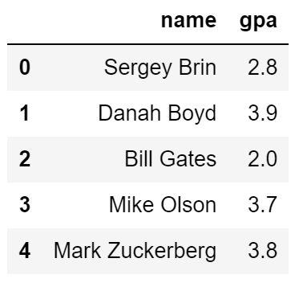
Find the name and GPA for all CS Students
SELECT name, gpa FROM students WHERE dept = 'CS'

Slide 19
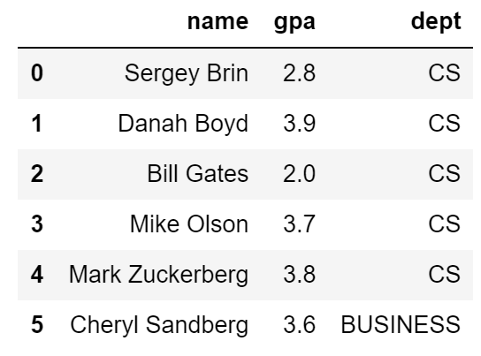
Combining predicates with OR and AND
SELECT name, gpa FROM students WHERE dept = 'CS’ OR name < ‘B’

Slide 20
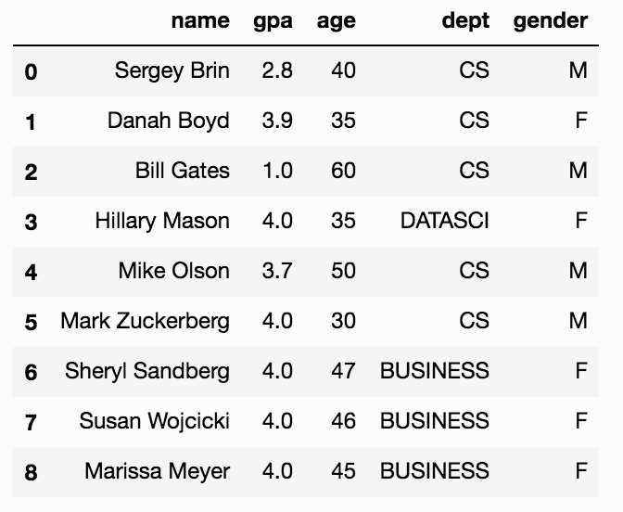
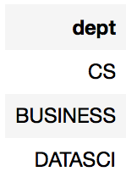
SELECT DISTINCT
SELECT DISTINCT dept FROM students [WHERE <predicate>] [GROUP BY <column list> [HAVING <predicate>] ] [ORDER BY <column list>] ;
DISTINCT flag specifies removal of duplicates before output

Slide 21
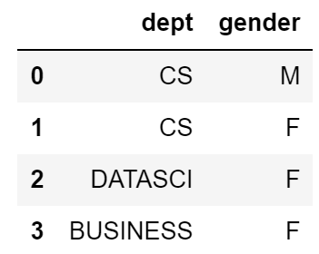
SELECT DISTINCT
SELECT DISTINCT dept, gender FROM students [WHERE <predicate>] [GROUP BY <column list> [HAVING <predicate>] ] [ORDER BY <column list>] ;
DISTINCT flag specifies removal of duplicates before output
DISTINCT operates at the tuple level, not the column level

Slide 22
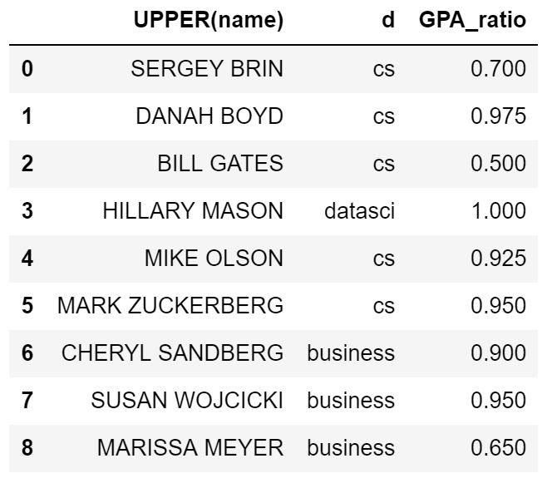
Functions in the SELECT list
Can provide functions in selection list.
AS lets us alias (name) our columns.
SELECT UPPER(name), LOWER(dept) AS d, gpa/4.0 AS GPA_ratio FROM students [WHERE <predicate>] [GROUP BY <column list> [HAVING <predicate>] ] [ORDER BY <column list>] ;

Slide 23

Aggregates
SELECT AVG(age) FROM students WHERE dept = 'CS' [GROUP BY <column list> [HAVING <predicate>] ] [ORDER BY <column list>] ;
Before producing output, compute a summary statistic
Aggregates include: SUM, COUNT, MAX, MIN, AVG, …
Produces 1 row of output → Still a table
Note: can use DISTINCT inside the agg function
SELECT COUNT(DISTINCT name) …

Slide 24
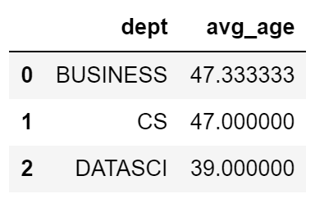
GROUP BY
SELECT dept, AVG(age) FROM students [WHERE <predicate>] GROUP BY dept [HAVING <predicate>] [ORDER BY <column list>] ;
Partition table into groups with same GROUP BY column values
Group By takes a list of columns
Produce an aggregate result per group
SELECT list can contain aggregates and GROUP BY columns only!
Important: When using GROUP BY, all columns in the SELECT clause must be either listed in the GROUP BY clause or have an aggregate function applied to them.

Slide 25
What if we wanted to only consider departments that have greater than two students?
SELECT dept, AVG(age) FROM students [WHERE <predicate>] GROUP BY dept [HAVING <predicate>] [ORDER BY <column list>] ;

Slide 26
What if we wanted to only consider departments that have greater than two students?
SELECT dept, AVG(age) FROM students WHERE COUNT(*) > 2 GROUP BY dept [HAVING <predicate>] [ORDER BY <column list>] ;
?
Doesn’t work … COUNT(*) here returns the number of rows in the table
WHERE clause is applied before GROUP BY
You cannot have aggregation functions in the where clause

Slide 27
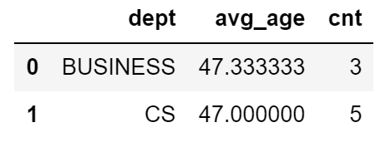
HAVING
SELECT dept, AVG(gpa) as avg_age, COUNT(*) as cnt FROM students [WHERE <predicate>] GROUP BY dept HAVING COUNT(*) > 2 [ORDER BY <column list>] ;
The HAVING predicate is applied after grouping and aggregation
Hence can contain anything that could go in the SELECT list
HAVING can only be used in aggregate queries
This also means that you cannot use HAVING without GROUP BY first!

Slide 28
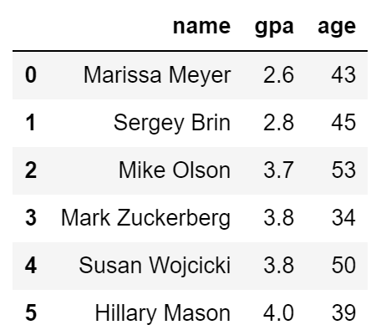
ORDER BY
SELECT name, gpa, age FROM students WHERE name > ‘E' [GROUP BY <column list> [HAVING <predicate>] ] ORDER BY gpa, name;
ORDER BY clause specifies output to be sorted
Lexicographic ordering
(By default) Words: Alphabetical
(By default) Numbers: Ascending

Slide 29
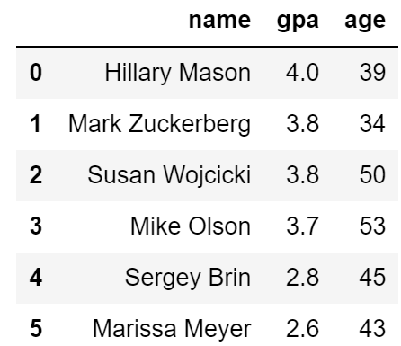
ORDER BY
SELECT name, gpa, age FROM students WHERE name > ‘E' [GROUP BY <column list> [HAVING <predicate>] ] ORDER BY gpa DESC, name ASC;
Ascending order by default
DESC flag for descending, ASC for ascending
Can mix and match, lexicographically
During mix and match, whichever column we specify first will be prioritized as the main level of ordering.

Slide 30
More on ORDER BY
The level of ordering is very helpful when it comes to
breaking ties within a table.
Name | Score
John | 40
Mary | 40
Anne | 30
Carter | 40
SELECT * FROM scores [WHERE <predicate>] [GROUP BY <column list> [HAVING <predicate>] ] ORDER BY Score ASC, Name DESC;
Name | Score
Anne | 30
Mary | 40
John | 40
Carter | 40
Break the ties of having the same scores with DSC on names
(2)
ASC
(1)

Slide 31
SQL vs. Pandas
Suppose we have a table stores with the columns product, price, ratings
SQL Queries | Semantically Equivalent Pandas Expressions
SELECT product, MAX(ratings) as max_rating FROM stores | prod = stores[[‘product’]]
WHERE price > 15 | prod = stores[stores[‘price’] > 15][[‘product’]]
GROUP BY product | rated = stores.groupby(‘product’)
HAVING max_rating >= 3 | max_rating = rated.max( ); high = max_rating.loc[max_rating[‘ratings’]>=3, [‘product’]]
LIMIT 5 | result = high.head(5);
Key Difference: In Pandas, you have to keep re-accessing and making sure you have the proper columns to work with (a lot of ‘[[ ]]’ instances).

Slide 32
Conceptual SQL Evaluation
SELECT [DISTINCT] target-list
FROM relation-list
WHERE qualification
GROUP BY grouping-list
HAVING group-qualification
Try Queries Here
http://sqlfiddle.com/#!17/67109/12
Form groups & aggregate
GROUP BY
[DISTINCT]
Eliminate duplicates
Project away columns
(just keep those used in SELECT, GBY, HAVING)
Apply selections
(eliminate rows)
WHERE
SELECT
One or more tables to use
(cross product …)
Eliminate groups
FROM
HAVING

Slide 33
LIMIT
SELECT [DISTINCT] <column expression list> FROM <single table> [WHERE <predicate>] [GROUP BY <column list> [HAVING <predicate>] ] [ORDER BY <column list>]
[LIMIT <number>];
The LIMIT clause lets us specify the maximum number of results to return. Similar to head().
Does not return a random sample!

Slide 34
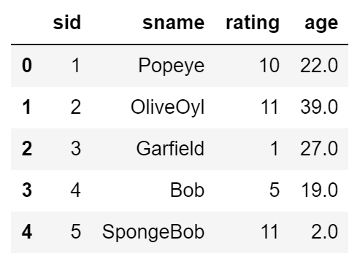
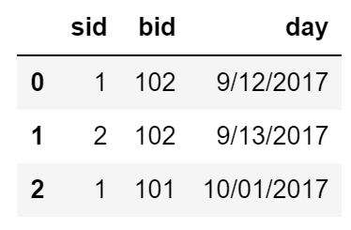
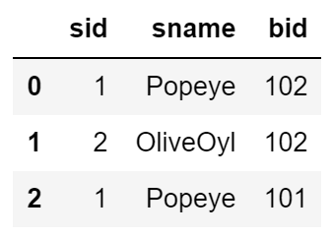
Basic Joins
SELECT s.sid, s.sname, r.bid
FROM Sailors s, Reserves r
WHERE s.sid = r.sid
AND s.age > 20;
Can select from multiple tables.
By ensuring sids are equal we get an inner join.
Will discuss joins in further depth in next Thursday’s (2/14) lecture
http://sqlfiddle.com/#!17/4215a/10

Slide 35
Test Your Understanding #1
SELECT dept, AVG(gpa) AS avg_gpa, COUNT(*) AS size FROM students WHERE gender = 'F' GROUP BY dept HAVING COUNT(*) > 2 ORDER BY avg_gpa DESC
What does this compute?
GROUP BY
[DISTINCT]
WHERE
SELECT
FROM
HAVING

Slide 36
Test Your Understanding #1
SELECT dept, AVG(gpa) AS avg_gpa, COUNT(*) AS size FROM students WHERE gender = 'F' GROUP BY dept HAVING COUNT(*) > 2 ORDER BY avg_gpa DESC
What does this compute?
The average GPA of female students and number of female students in each department where there are at least 3 female students in that department. The results are ordered by the average GPA.
GROUP BY
[DISTINCT]
WHERE
SELECT
FROM
HAVING

Slide 37
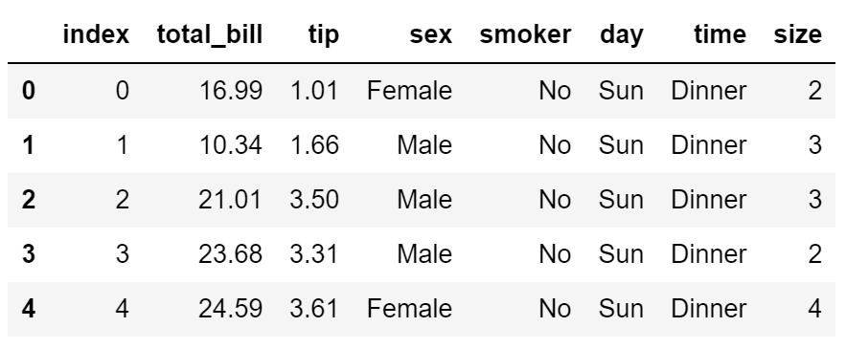
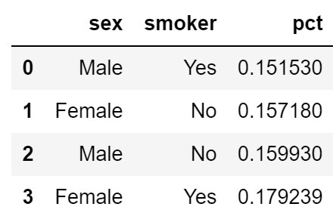
Test Your Understanding #2
SELECT ???? FROM tips WHERE ???? GROUP BY ???? HAVING ???? ORDER BY ????
Suppose we want to compare smoker vs. non-smoker and female vs. male tips for weekend diners. Create a table ordered by percentage tip that gives the average tip for all four possibilities.

Slide 38
Test Your Understanding #2
SELECT sex, smoker, avg(tip/total_bill) as pct FROM tips WHERE day = 'Sun' OR day = 'Sat' GROUP BY sex, smoker HAVING ORDER BY pct
Suppose we want to compare smoker vs. non-smoker and female vs. male tips for weekend diners. Create a table ordered by percentage tip that gives the average tip for all four possibilities.

Slide 39
Worksheet Problems

Slide 40
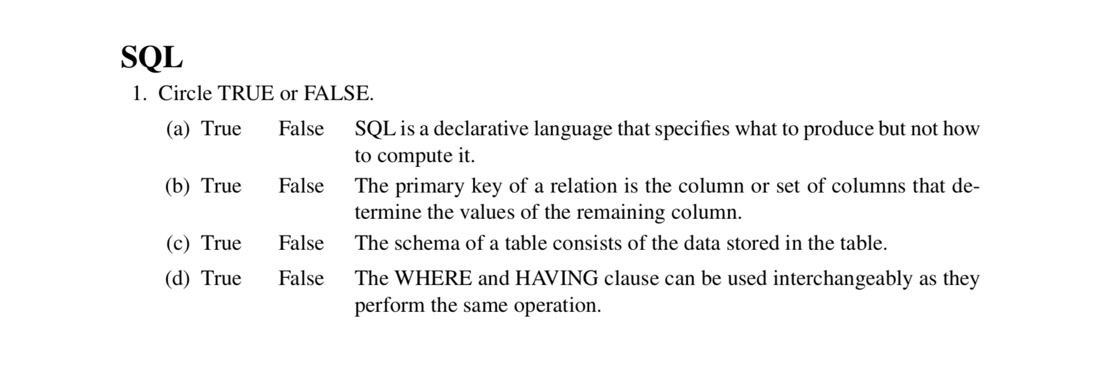
SQL True/False

Slide 41
SQL is a declarative language that specifies what to produce but not how
to compute it.

Slide 42
SQL is a declarative language that specifies what to produce but not how
to compute it.
SQL is declarative programming language which specifies what the user
wants to accomplish allowing the system to determine how to accomplish it.

Slide 43
SQL is a declarative language that specifies what to produce but not how
to compute it.
SQL is declarative programming language which specifies what the user
wants to accomplish allowing the system to determine how to accomplish it.
The primary key of a relation is the column or set of columns that determine the values of the remaining column.

Slide 44
SQL is a declarative language that specifies what to produce but not how
to compute it.
SQL is declarative programming language which specifies what the user
wants to accomplish allowing the system to determine how to accomplish it.
The primary key of a relation is the column or set of columns that determine the values of the remaining column.
Similar to how pandas works!.

Slide 45
SQL is a declarative language that specifies what to produce but not how
to compute it.
SQL is declarative programming language which specifies what the user
wants to accomplish allowing the system to determine how to accomplish it.
The primary key of a relation is the column or set of columns that determine the values of the remaining column.
Similar to how pandas works!.
The schema of a table consists of the data stored in the table

Slide 46
SQL is a declarative language that specifies what to produce but not how
to compute it.
SQL is declarative programming language which specifies what the user
wants to accomplish allowing the system to determine how to accomplish it.
The primary key of a relation is the column or set of columns that determine the values of the remaining column.
Similar to how pandas works!.
The schema of a table consists of the data stored in the table
The schema of a table consists of the column names, their types, and any
constraints on those columns. The instance of a database is the data stored in the
database.

Slide 47
SQL is a declarative language that specifies what to produce but not how
to compute it.
SQL is declarative programming language which specifies what the user
wants to accomplish allowing the system to determine how to accomplish it.
The primary key of a relation is the column or set of columns that determine the values of the remaining column.
Similar to how pandas works!.
The schema of a table consists of the data stored in the table
The schema of a table consists of the column names, their types, and any
constraints on those columns. The instance of a database is the data stored in the
database.
The WHERE and HAVING clause can be used interchangeably as they
perform the same operation

Slide 48
SQL is a declarative language that specifies what to produce but not how
to compute it.
SQL is declarative programming language which specifies what the user
wants to accomplish allowing the system to determine how to accomplish it.
The primary key of a relation is the column or set of columns that determine the values of the remaining column.
Similar to how pandas works!.
The schema of a table consists of the data stored in the table
The schema of a table consists of the column names, their types, and any
constraints on those columns. The instance of a database is the data stored in the
database.
The WHERE and HAVING clause can be used interchangeably as they
perform the same operation
The having clause is used to filter out groups, while the where clause op-
erates on individual rows

Slide 49
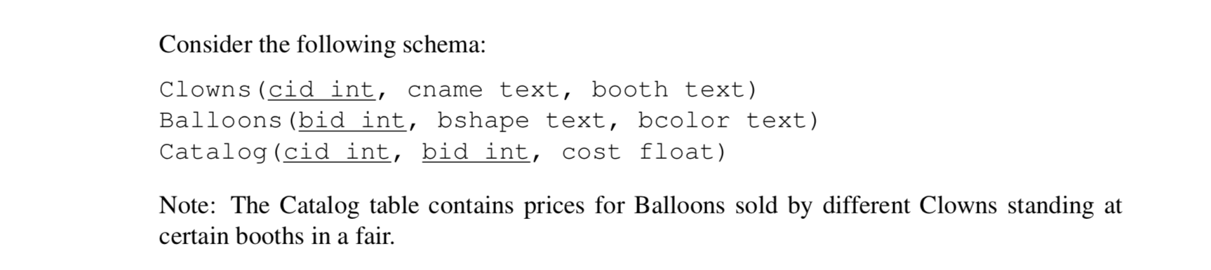
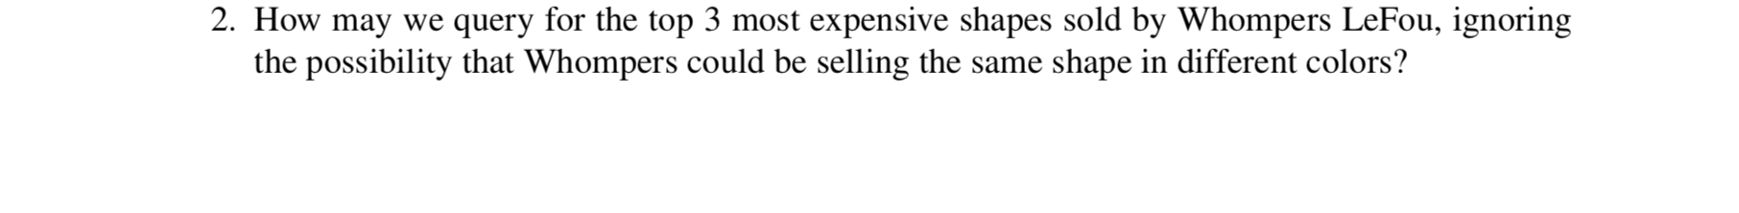
Question 2

Slide 50
Question 2
SELECT ___________
FROM ____________________
WHERE _______________________
AND ___________________________
AND ___________________________
ORDER BY _________________
LIMIT _____;

Slide 51
Question 2
SELECT ___________
FROM Clowns, Balloons, Catalog
WHERE _______________________
AND ___________________________
AND ___________________________
ORDER BY _________________
LIMIT _____;

Slide 52
Question 2
SELECT bshape, cost
FROM Clowns, Balloons, Catalog
WHERE Clowns.cid = Catalog.cid
AND Balloons.bid = Catalog.bid
AND Clowns.cname = 'Whompers LeFou'
ORDER BY _________________
LIMIT _____;
Match the catalog row to the right clown and the right balloon
Filter to only keep the clown of interest

Slide 53
Question 2
SELECT bshape, cost
FROM Clowns, Balloons, Catalog
WHERE Clowns.cid = Catalog.cid
AND Balloons.bid = Catalog.bid
AND Clowns.cname = 'Whompers LeFou'
ORDER BY cost DESC
LIMIT 3;
Match the catalog row to the right clown and the right balloon
Filter to only keep the clown of interest
Order from the most expensive shape going down

Slide 54
Question 2
SELECT bshape, cost
FROM Clowns, Balloons, Catalog
WHERE Clowns.cid = Catalog.cid
AND Balloons.bid = Catalog.bid
AND Clowns.cname = 'Whompers LeFou'
ORDER BY cost DESC
LIMIT 3;

Slide 55
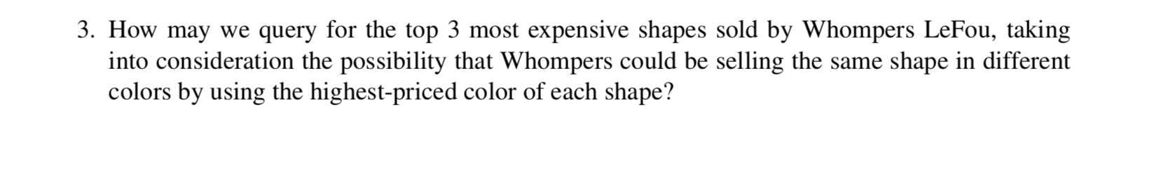
Question 3

Slide 56
Question 3
SELECT _____________________
FROM ______________________
WHERE ____________________
AND _____________________
AND _____________________
GROUP BY ___________
ORDER BY ___________
LIMIT ___;

Slide 57
Question 3
SELECT _____________________
FROM Clowns, Balloons, Catalog
WHERE Clowns.cid = Catalog.cid
AND Balloons.bid=Catalog.bid
AND Clowns.cname = 'Whompers LeFou'
GROUP BY ___________
ORDER BY ___________
LIMIT ___;

Slide 58
Question 3
SELECT bshape, MAX(cost)
FROM Clowns, Balloons, Catalog
WHERE Clowns.cid = Catalog.cid
AND Balloons.bid=Catalog.bid
AND Clowns.cname = 'Whompers LeFou'
GROUP BY bshape
ORDER BY cost DESC
LIMIT 3;
Regroup the data set by bshape (similar to pandas where we reorganize the data by a new index)

Slide 59
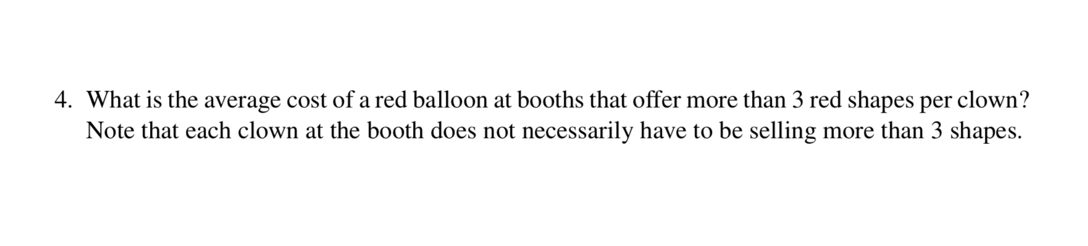
Question 4

Slide 60
Question 4
SELECT ______________
FROM Clowns, Balloons, Catalog
WHERE _____________________
AND __________________
AND __________________
GROUP BY _____________
HAVING _________________________________________________

Slide 61
Question 4
Using aggregate functions like AVG can make our lives easier
SELECT booth, avg(cost)
FROM Clowns, Balloons, Catalog
WHERE Clowns.cid = Catalog.cid
AND Balloons.bid=Catalog.bid
AND bcolor='red'
GROUP BY _____________
HAVING _________________________________________________

Slide 62
Question 4
Using aggregate functions like AVG can make our lives easier
SELECT booth, avg(cost)
FROM Clowns, Balloons, Catalog
WHERE Clowns.cid = Catalog.cid
AND Balloons.bid=Catalog.bid
AND bcolor='red'
GROUP BY booth
HAVING _________________________________________________

Slide 63
Question 4
Using aggregate functions like AVG can make our lives easier
SELECT booth, avg(cost)
FROM Clowns, Balloons, Catalog
WHERE Clowns.cid = Catalog.cid
AND Balloons.bid=Catalog.bid
AND bcolor='red'
GROUP BY booth
HAVING COUNT(DISTINCT bshape)/COUNT(DISTINCT Clowns.cid) > 3
We want the ratio of clowns at any booth to be >⅓ the ratio of num shapes at a booth

Slide 64
Question 4
SELECT booth, avg(cost)
FROM Clowns, Balloons, Catalog
WHERE Clowns.cid = Catalog.cid
AND Balloons.bid=Catalog.bid
AND bcolor='red'
GROUP BY booth
HAVING COUNT(DISTINCT bshape)/COUNT(DISTINCT Clowns.cid) > 3

Slide 65
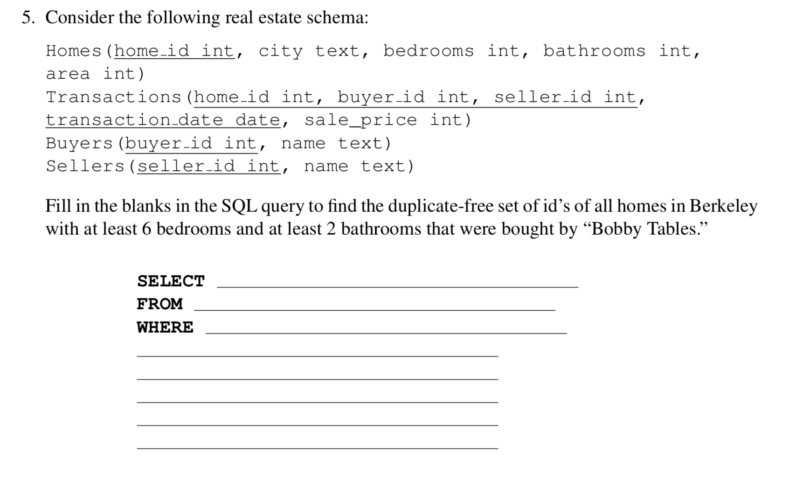
Question 5

Slide 66
Question 5
SELECT ______________________
FROM ________________________
WHERE _______________________
______________________________
______________________________
______________________________

Slide 67
Question 5
SELECT DISTINCT H.home id FROM Homes H, Transactions T, Buyers B
WHERE H.home id=T.home id AND T.buyer id=B.buyer id
AND H.city="Berkeley" AND H.bedrooms>=6
AND H.bathrooms>=2
AND B.name=’Bobby Tables’;

